Slide 1
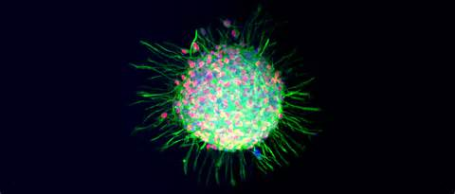
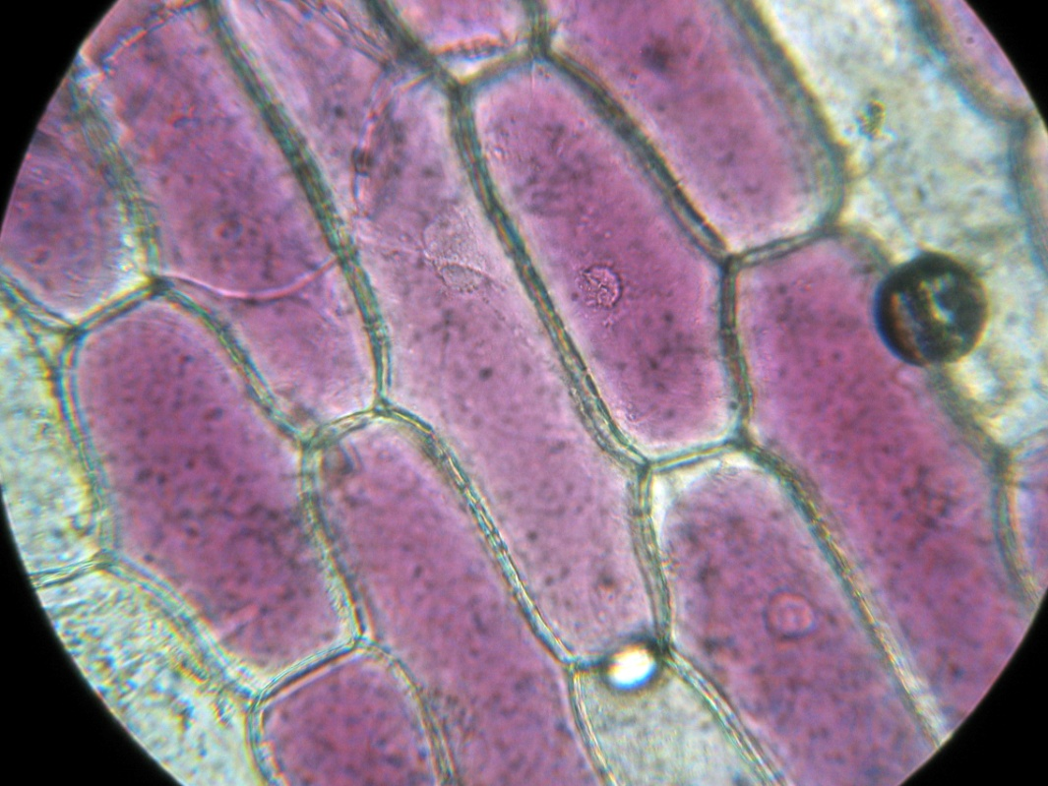
Topic 2- Cells
Wenting Chai

Slide 2
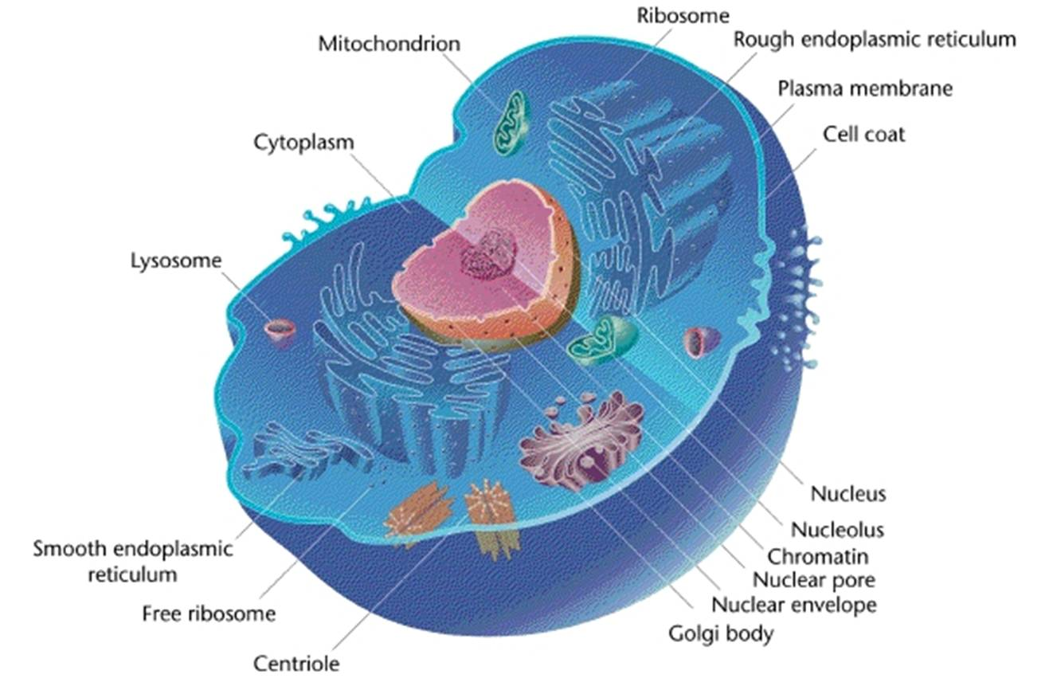
Animal cell

Slide 3
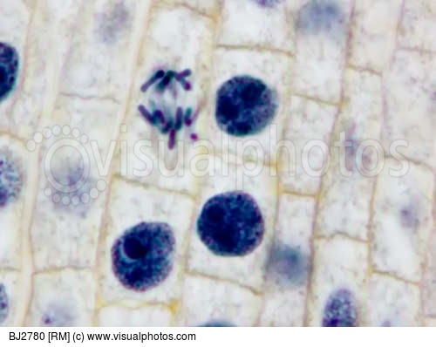
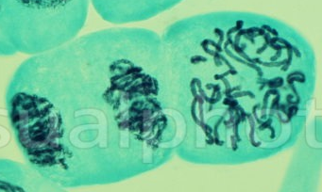
Nucleus
It contains the genetic information in the form of chromosomes which are made of DNA, the genes on which carries instructions that control the activities of a cell.

Slide 4
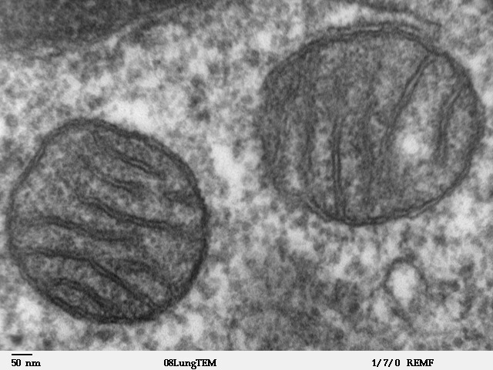
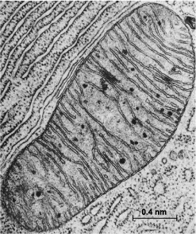
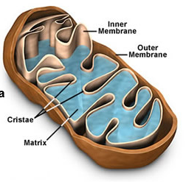
Mitochondria
Q: Can you suggest 3 specialised cells where you can find a lot of mitochondria?

Slide 5
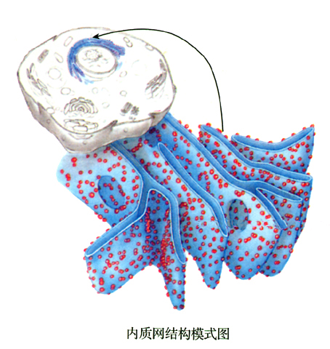
ER & Ribosomes

Slide 6
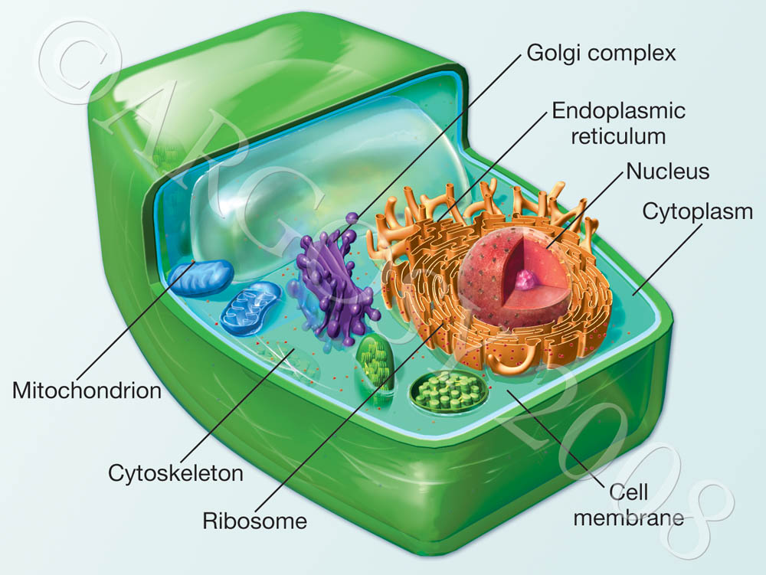
Plant cell

Slide 7
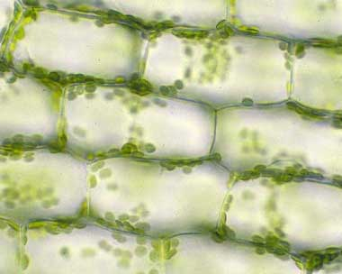
Cell wall

Slide 8
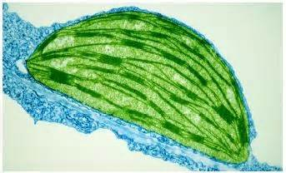
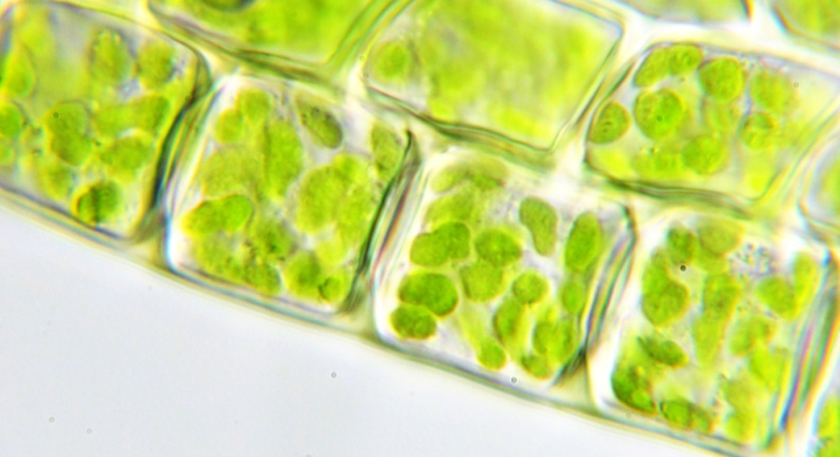
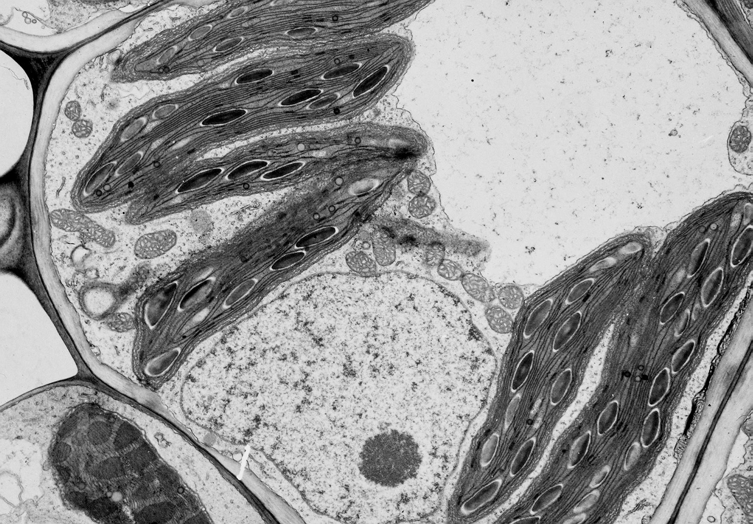
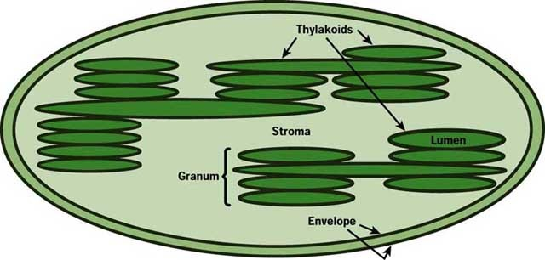
Chloroplast
What would happen if animals had Chloroplasts?

Slide 9
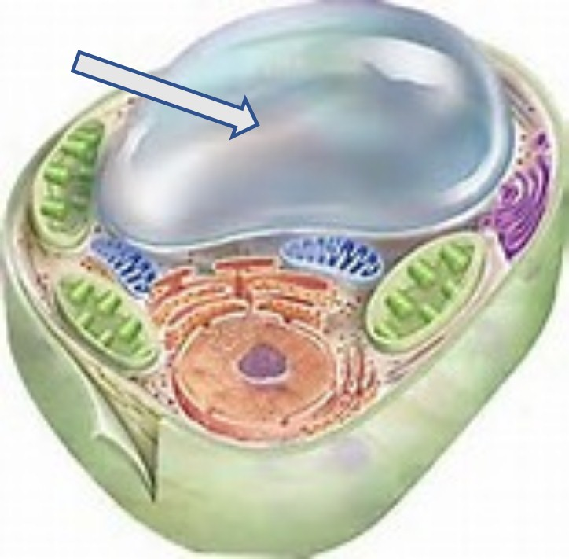
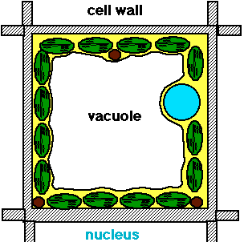
vacuoles
Plant cells usually have a large central vacuole which help maintain a turgor (stiffness) in the plant, and is filled with a liquid called cell sap.

Slide 10
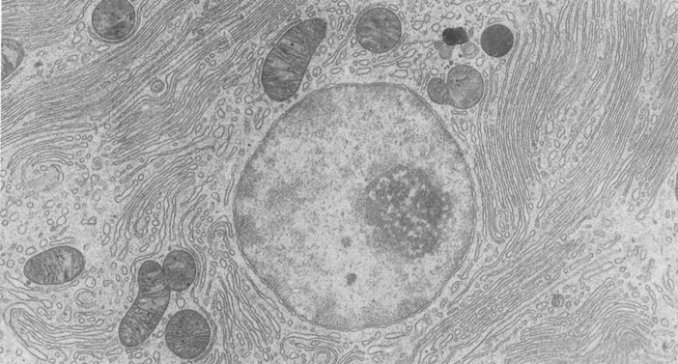

Slide 11
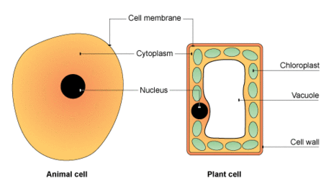
Animal cells VS. Plant cells

Slide 12
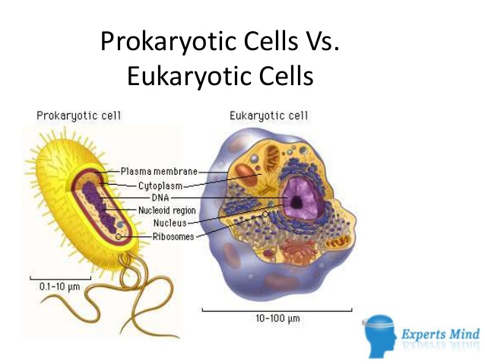
Prokaryotic cell VS. Eukaryotic cell

Slide 13
